Slide 1

MCGraph:
Multi-criterion representation for scene understanding
Moos Hueting∗ Aron Monszpart∗ Nicolas Mellado
University College London
https://www.imagestore.ucl.ac.uk/home/pcache/10002/aa/black_ad80e.jpg

Slide 2
Motivation
Indoor scene analysis
  Acquisition easier
  Less constrained scenes, growing complexity
  Target more complex:
    object counting → segmentation, labelling
Notes:
Indoor scene analysis
Acquisition has become easier
Scenes become less constrained, have growing complexity
Target more complex: object counting → segmentation, labelling
Typical processing:
Vision (SLAM)
Elements: 2D images, temporal information, depth maps, pointclouds, 3D models
Tasks: localization, mapping
3D
Elements: pointclouds, shapes, 3D meshes
Tasks: local geometric or multiscale features, abstraction by primitives, shapes from collections, inference of categorical knowledge, functional information (interaction)

Slide 3
Motivation
Indoor scene analysis
  Acquisition easier
  Less constrained scenes, growing complexity
  Target more complex:
    object counting → segmentation, labelling
Typical processing:
Vision (SLAM) | 3D
2D images, temporal information, depth maps, pointclouds, 3D models | pointclouds, shapes, 3D meshes
localization, mapping, reconstruction, model recognition and fitting | local geometric or multi-scale features, abstraction by primitives, shapes from collections, inference of categorical knowledge, functional information (interaction)
Notes:
Indoor scene analysis
Acquisition has become easier
Scenes become less constrained, have growing complexity
Target more complex: object counting → segmentation, labelling
Typical processing:
Vision (SLAM)
Elements: 2D images, temporal information, depth maps, pointclouds, 3D models
Tasks: localization, mapping
3D
Elements: pointclouds, shapes, 3D meshes
Tasks: local geometric or multiscale features, abstraction by primitives, shapes from collections, inference of categorical knowledge, functional information (interaction)

Slide 4
Motivation
Few types of information at a time
Complex scene understanding → different information domains at the same time
Stacked, disjoint abstraction layers
Joint representation with mutual refinement
Concurrent information processing > iterative
Notes:
Only few types
For complex scene understanding we need to consider different information domains at the same time
Disjoint abstraction layers stacked is worse, than
Mutually refined, joint representation
Considering different information domains at the same time is better, then in turn
(Many techniques have been researched across different fields for the purpose of scene analysis. The range of approaches proposed is highly diverse and input-dependent. In geometry processing, where input is often given as 3D data such as meshes and pointclouds, techniques range from local geometric descriptors and multiscale feature extraction to scene abstraction using either 3D primitives or shapes from a given collection. The resulting abstractions are used for inferring a multitude of types of information.)

Slide 5
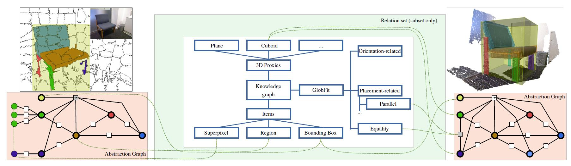
MCGraph
MCGraph – a unified Multi-Criterion data representation
Structure and meaning modelled separately,
connected fully
For understanding and processing of large-scale 3D scenes
A standardized structure to format the data created by our community
Discovered knowledge
Prior knowledge
Abstraction graph
Notes:
We present graph-based data representation, that separates prior and discovered knowledge
Data type independent
Compatible with state-of-the-art algorithms
Knowledge: i.e. Geometric abstraction, functional and semantic analysis
Multi-criteria means, that we can represent these in our model
Why are we doing this? Well, it’s worth having a look at current state-of-the-art indoor sceneunderstanding related work.

Slide 6
Related work - viewpoints
 | 2D | 3D
Arrangements of … | features [Felzenszwalb10] , … | recurring parts in shape collections [Zheng14] , …
Notes:
Indoor scene analysis can investigate arrangements of features and recurring parts as low level building blocks

Slide 7
Related work - viewpoints
 | 2D | 3D
Arrangements of … | features [Felzenszwalb10] , … | recurring parts in shape collections [Zheng14] , …
Abstraction by … | super-pixels [Zitnick04], … regions [Gould09, Kumar10] , … features[Hoiem08] , … | planes [Gallup07] , … primitives [Schnabel07] , … cuboids [Fidler12,Shao14] , …
Notes:
Many method use abstractions,
by super-pixels and regions
as well as planes, primitives, cuboids

Slide 8
Related work - viewpoints
 | 2D | 3D
Arrangements of … | features [Felzenszwalb10] , … | recurring parts in shape collections [Zheng14] , …
Abstraction by … | super-pixels [Zitnick04], … regions [Gould09, Kumar10] , … features[Hoiem08] , … | planes [Gallup07] , … primitives [Schnabel07] , … cuboids [Fidler12,Shao14] , …
Graph bases representation of … | RGB segmentation [FelzenszwalbHuttenlocher04], [Rother04], … | RGBD segmentation [Zheng13], … inter-shape analysis [Mitra14], … joint shape segmentation [Huang11], ... shape collections [Fish*14], …
Notes:
Representing the problem as a graph makes sense,
As demonstrated by successful methods performing rgbD segmentation or analysis of shape collections

Slide 9
Related work - criteria
Few criteria
  Appearance co-occurrence, relative spatial layout [Hedau10]
  Primitive abstraction, physics [Gupta10]
  Semantic labelling [Huang13]
Notes:
Seeing the different types of aspects used, we investigated,
what kind of relations are useful to analyse.
We have identified cases, where people designed solutions, that use the power of multi-criteria analysis.

Slide 10
Related work - criteria
Few criteria
  Appearance co-occurrence, relative spatial layout [Hedau10]
  Primitive abstraction, physics [Gupta10]
  Semantic labelling [Huang13]
Multi-criteria 2D
  Appearance, shape, context [Shotton09]
  Verbal descriptions of actors, actions + object properties, relations [Zitnick13]
  Material, function, spatial envelope [Patterson14]

Slide 11
Related work - criteria
Few criteria
  Appearance co-occurrence, relative spatial layout [Hedau10]
  Primitive abstraction, physics [Gupta10]
  Semantic labelling [Huang13]
Multi-criteria 2D
  Appearance, shape, context [Shotton09]
  Verbal descriptions of actors, actions + object properties, relations [Zitnick13]
  Material, function, spatial envelope [Patterson14]
Multi-criteria 3D
  Regularities of shape collections, function [Laga13]
  Intra and inter-object symmetries, physics, function [Mitra10]
Notes:
We have identified cases, where people designed solutions, that use the power of multi-criteria analysis.
MULTI-CRIT representation needed!

Slide 12
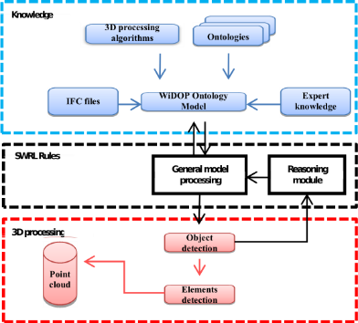
Related work – formalisation
Information fusion
  Multi-Criteria Decision Analysis [Doumpos13]
Hypergraphs [Zhang14]
  Low-level processing
Hmida et al. [2013]
  Separates knowledge from abstraction
  Processing and representation coupled
[Hmida et al. 2013]
Notes:
Knowledge sub-graph to incorporate expert knowledge into vision
The concept of graph fusion exist in business intelligence.
Called information fusion and mcda
Multigraphs in vision used by Zhang et al for low level image processing tasks, not formalized.
Hmida
“Knowledge base approach for 3d objects detection in point clouds using 3d processing and specialists knowledge”

Slide 13
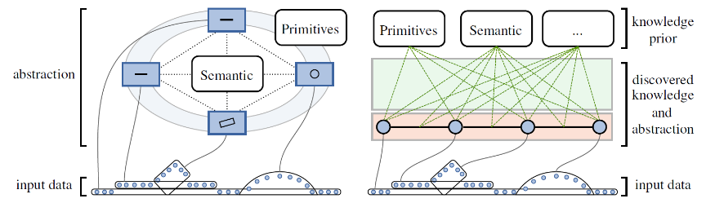
Classic model
Prior knowledge:
  Graph nodes (object types)
  Graph edges (relationship types)
Discovered knowledge:
  Graph layout
Coupled representation of a priori and discovered

Slide 14
Proposed model
Prior knowledge, discovered knowledge and abstraction separate
Inspired by graph databases
  Labelling = edge between object and label
Supports multi-criteria processing

Slide 15
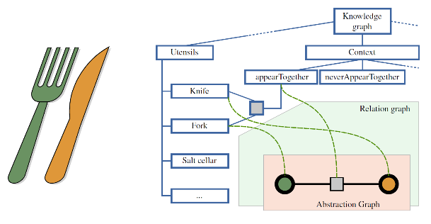
1. Abstraction graph
Represents objects and relations
Abstractions may be connected to segments of data
Segments can be overlapping
Object hierarchies
Notes:
abstractions not connected to the data allow to form object hierarchies

Slide 16
2. Knowledge graph
Encodes prior knowledge -> “knowledge units”
Hierarchical
Multi-criterion by separate sub-graphs
Is defined a priori - portable
Can have internal edges
Notes:
Not just a label – can be parameterized
It has been shown, that having a hierarchy of prior information helps [Wu14]
(topological sub-graph → classification sub-graph)

Slide 17
3. Relation set
Represents discovered knowledge, “labellings”
Abstractions ←→ labels, or
relation nodes ←→ labels
Edge can store parameters to represent an instantiation (i.e. primitive size)

Slide 18
Example
Segmentation knowledge sub-graph
Regions
Super-pixels

Slide 19
Example
Bounding box
Bounding box
Segmentation knowledge sub-graph

Slide 20
Example
Abstraction knowledge sub-graph

Slide 21
Example
Relations knowledge sub-graph

Slide 22
Example
Legs same size, and parallel

Slide 23
Common knowledge sub-graphs
Primitive proxies
  I.e. primitive – polyhedron – cuboid, pyramid
  Hierarchy induces high inference power
Semantic
  Hierarchical object labels
  Classification, function, etc.
Relationships
  Coaxial, co-planar, equiangular [Li11]
  Covers, supports, occluded by, belong together [Gupta10]
  Can be searched by sub-graph matching [Schnabel08]

Slide 24
Common knowledge sub-graphs
Primitive proxies
  I.e. primitive – polyhedron – cuboid, pyramid
  Hierarchy induces high inference power
Semantic
  Hierarchical object labels
  Classification, function, etc.
Relationships
  Coaxial, co-planar, equiangular [Li11]
  Covers, supports, occluded by, belong together [Gupta10]
  Can be searched by sub-graph matching [Schnabel08]
Large freedom, high representational power
Use cases: Primitive abstraction, RGBD annotation
  See paper

Slide 25

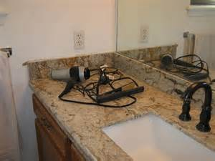

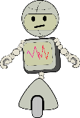
Extension 1. Scene collections for assisted living
Robot assistant needs to be able to reach the subject at all times
Pro-active discovery of dynamic environment
  Needs to identify danger sources
Vision, scene-collections, intra-domain inference
MCGraph:
  “Objects that easily tip over, and incur danger, when in contact with water”
Electric, movable, unstable
Emits water
Movable
Notes:
Physically stable
Function: work with electricity, emits water
Vision: train on common and uncommon scene configurations, over long time, simplistic object modelling?
Scene collections: co-segment objects, identify object function, affordance and non-rigidity, analyse co-occurrence to discover unusual scenes
[Huang2013] showed, that incomplete labelling is enough for semantic inference – “objects that tip over”, “objects that incur danger, when in contact with water”

Slide 26
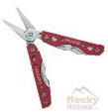
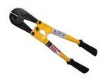

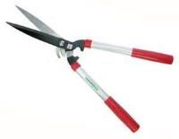



Extension 2. - Multi-criteria multi-scale
Multi-scale analysis of scene understanding [Mitra14]
  HKS [Sun09], GLS [Mellado12]
  Multi-scale similarity queries [Hou12]
Only spatial domain, controlled environments
Open-world problem
Multi-criteria multi-scale look-ups
Classification
Scale
Time
Location
?
Scan
Notes:
Intra-domain analysis is useful
On the time of the year, geographic location, or function.
a large, scissor-like object in New Jersey in July is likely to be a hedge trimmer, that was forgotten on the kitchen table, and should be placed back in the garden shed.
A small one in Kyoto in December is more probable to be a Bonsai leaf trimmer and might have been put there by the owner, as a reminder to perform the weekly trimming.
: continuously growing model database with unreliable labellings and scale information

Slide 27
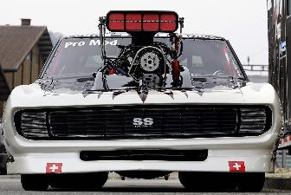
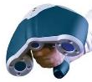
Extension 3. Prior knowledge for object registration
Geometric priors, priors on part-relations, function
If you discover, what you are scanning, you can use the extra information to enhance quality
generic car model prior
looks like car
looks like engine
generic engine model prior
Co-occurrence
will have shiny material
lookup working CAD model
function
decrease RGB weight in registration
will have axes and wheels

Slide 28
Conclusion
Limitations
  Portability -> standardization
  Diversity -> efficiency
Data online
Flexible and extendable representation
A data structure to standardize storage of annotated data
Can start a discussion, debate and movement how to harness the powers of multi-criteria problem representations, focused on 3D scene understanding

Slide 29
Thank you! http://geometry.cs.ucl.ac.uk/projects/2014/mcgraph/

